Slide 1
Collaborative Use of STEM: a Minecraft adventure
Kim Joyce
Brian Sharpe
Renee Lynch

Slide 2
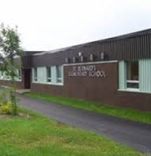
St. Bernard’s Elementary
Our school is located in Witless Bay, NL. It is a K-6 school with approximately 375 students. Our school services the Southern Shore communities from Bay Bulls to Tors Cove. We are in a growing school with 2 – 3 streams.

Slide 3
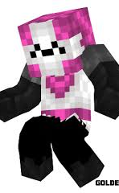
Kim Joyce
I have been teaching for fifteen years. I have been in Grade Three for five years at St. Bernard’s Elementary. I believe students gain more knowledge and a deeper understanding when collaborating with their peers.

Slide 4
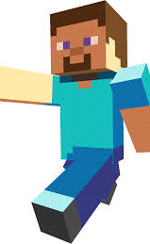
Brian Sharpe
I have been a teacher for about 10 years with experience in many grade levels. This is my third year in Grade Three. I believe students need to use what they learn to make it meaningful. Knowledge that isn’t used is so easily lost.

Slide 5
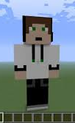
Renee Lynch
I have been teaching for 15 years. Most of my teaching experience has been in grades 4 and 5, with some experience teaching Special Needs and Challenging Needs. This is my first time teaching Grade 3 full time. I believe motivation is a key factor in student achievement.

Slide 6
Our students
We are currently working with the largest group in our school: 64 Grade Three students. There are 33 males and and 31 females. Overall, there are a wide variety of abilities in the group. We have 12 students on programming. A high percentage of the students had previous experience with Minecraft, but for a few, the learning curve was steep. Two students, due to exceptionalities (Autism, cognitive delay – visual impairment) have been creating either orally, with the aide of peers or with less restrictive parameters.

Slide 7
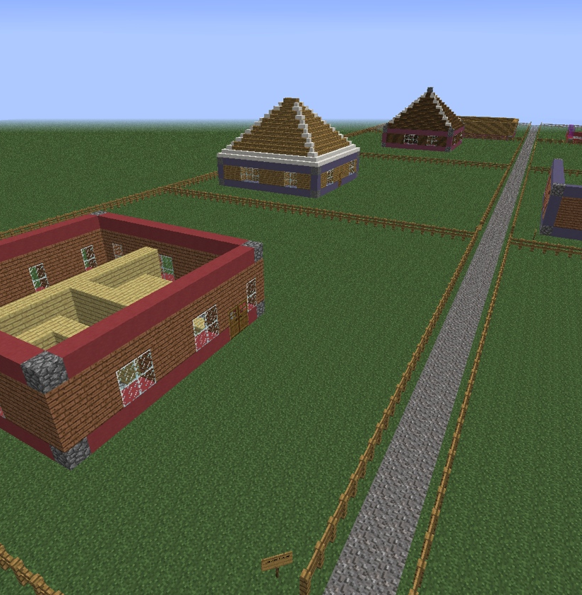
Focus Area
The focus of this year’s project was collaboration. Last year, we focused on the design process, from an individual basis. This year, students had to design, create and build collaboratively.

Slide 8
Research Questions
Teacher
What is the role of the teacher in using technology and collaboration through an integrated curriculum to enhance our students learning?
Student
How does technology, using Minecraftedu, and collaboration enhance learning for all students?

Slide 9
Ethical Considerations
Several procedures were followed for ethical consideration:
1. Permission forms were sent home for parents to sign, giving consent for their child to be interviewed and video recorded for Memorial University.
2. A parent information letter and consent form was sent home giving teachers permission to document students and their work.

Slide 10
Implementation
Ensure all units were taught; Math – Geometry; Science – Build It Up.
Reactivate Minecraftedu subscription and update all computers.
Download “Tutorial World” on Minecraftedu.
Order Lego blocks
Design five different house plans for students.

Slide 11
Curriculum
Math: Geometry
Science: Build It Up
To begin, the students needed an understanding of geometric shapes, solids and their attributes (faces, edges and vertices).
In science, the students learned about the purpose of a solid foundation and the materials needed to construct walls that support the required roof design.

Slide 12
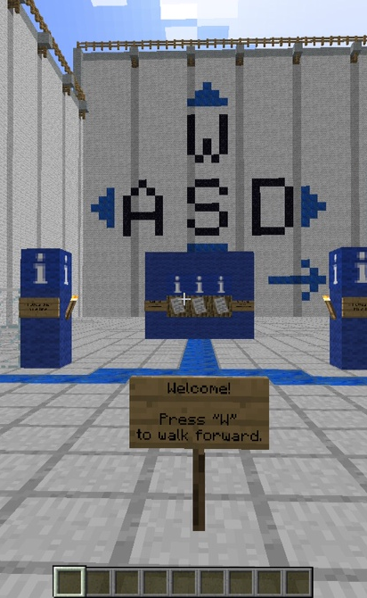
Minecraftedu: Tutorial World
The students were introduced to the game through Tutorial World. In this world, students learned how to use a keyboard to navigate and build. Most students had experience with the game on an iPad.

Slide 13
House Plans
Phase 1
Based on our observations of the students in Tutorial World, we organized our students into mixed ability groups. We designed five house plans for the students to select from. Each house had either a square based prism or rectangular based prism for the base of their house. The roof was a square based pyramid or a triangular based prism.

Slide 14
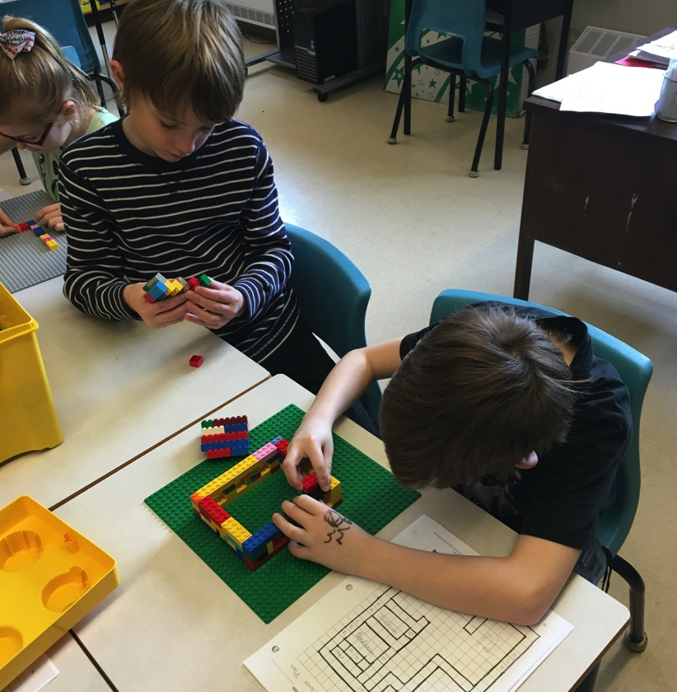
Lego Blocks
Each group of students were given a set of plans to construct a model of their house using Lego blocks. They had to match the size, placement of windows and doors and roof shape with the plans.

Slide 15
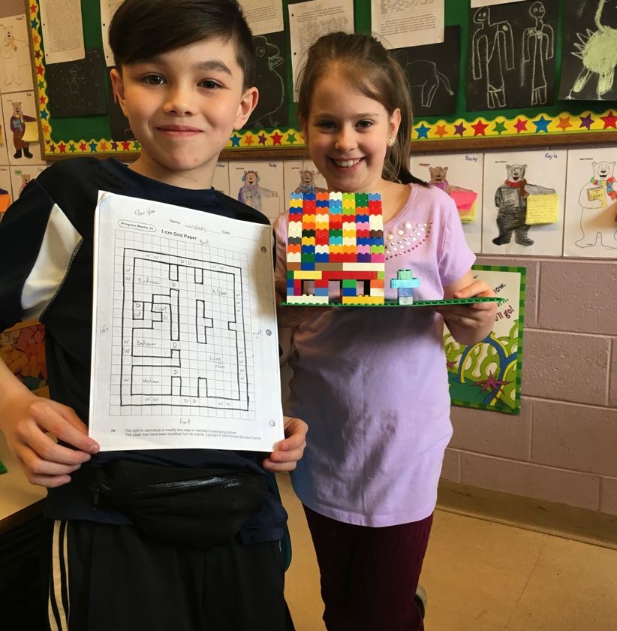
Observations #1
While constructing their Lego houses in groups, we noticed all children participated in the process. At least one student was assessing the house plans to see block placement was correct. Another one or two were looking for the correct size of blocks needed and another student was placing the blocks. Within each group, sometimes the roles changed or remained the same, during the process.

Slide 16
Stumbling Block #1
During the process of building Lego houses in groups, some conflict arose between students. The conflicts were based on role responsibilities, power struggles, difference of opinion, and exclusion. Another challenge, apart from collaboration, was the ability to follow the plans and understand scale. (The scale we used was one circle on a Lego block was equal to one square block in Minecraft).

Slide 17
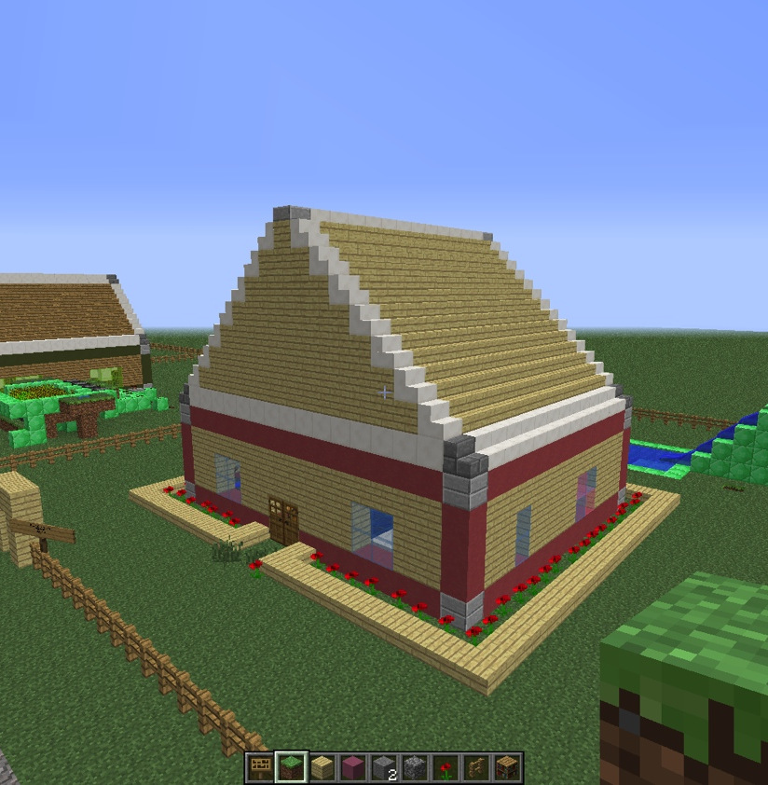
Minecraftedu: House Construction
After Lego construction, students were given a 40X40 plot of land in Minecraft to construct their individual house. Each student had a plot on their class street. Materials were assigned to distinguish faces, edges and vertices on their finished homes (stone vertices, clay edges and wood faces).

Slide 18
Stumbling Block #2
There were many challenges during this stage:
Correct dimension of their foundation.
Proper materials for faces, edges and vertices.
Proper placement of windows and doors.
Correct shape and materials for roof.

Slide 19
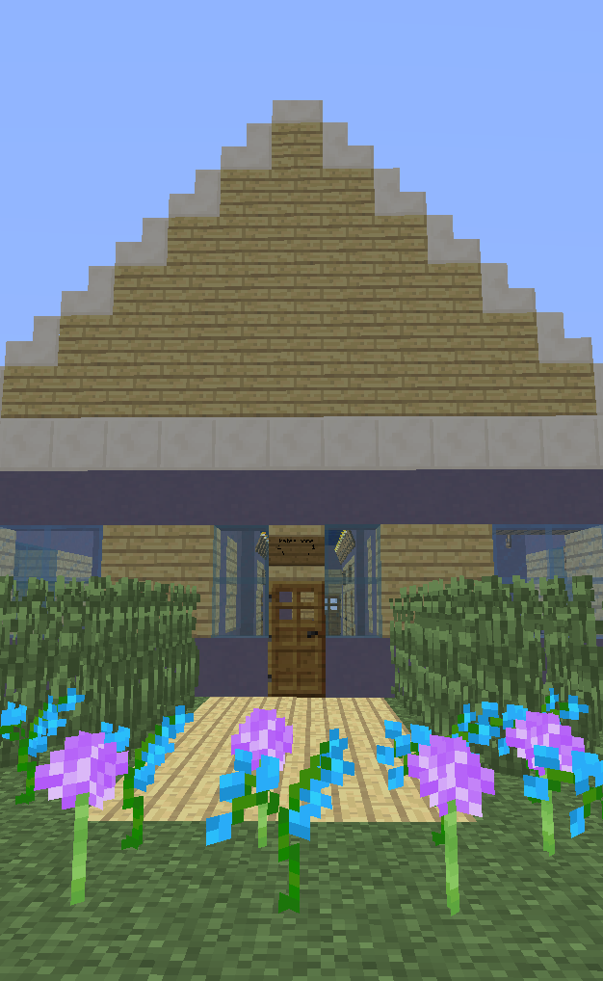
Assessment #1
When houses were complete, using house plans as a guide, each student had to give a tour to their teacher. Based on the outside view and blocks assigned, we could determine if the student had a solid understanding of geometric attributes. During the inside tour, we assessed their ability to follow their plan, based on counting blocks for window, door, and wall placement. Once assessment was complete, students were free to decorate their houses and property.

Slide 20
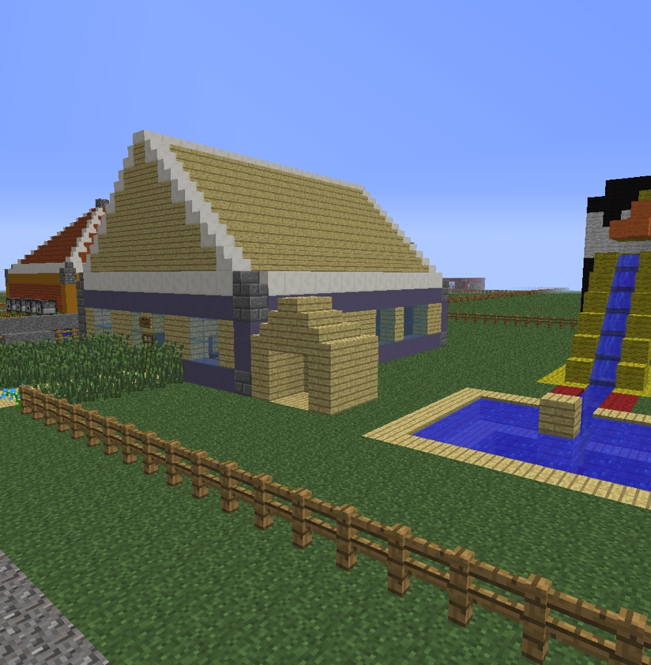
Free Play
Once assessment was complete, students were given some freedom of expression. They were free to decorate their houses and property. They were only limited by their imagination!

Slide 21
Collaborative Community Design
Phase 2
When we began the collaboration part of our project, teachers had to create streets and building lots in a flat world. Once this was complete we started the process with the students. To begin, classes brainstormed a list of structures, other than homes, found in a typical community. Next. students generated a list of questions about physical characteristics to factor into their design. For example, “What will it be used for, how many rooms will it need?”, “How large should it be and will it need a parking lot?”. Once students were placed in groups ( mixed ability), they were able to decide on a structure they wanted to build. They answered the questions they generated about design. When these steps were complete they were able to design their building plans. Once these were approved by the teacher they could begin their build.

Slide 22
Stumbling Block #3
Resolving conflict during collaboration:
Teacher only mediates
Students give ideas about how to resolve their differences
Chose an idea and stick with it
For example: Students could not agree on a type of block for their exterior walls.
The ideas given were:
1. Choose a completely different material
2. Vote best 2/3
3. Use both types of blocks
They decided on #3 but still had to agree on how to use both. I left it to them and they had an agreement by the end of the day.

Slide 23
DATA COLLECTION/ANALYSIS
Several methods were used to collect data:
Student surveys
Anecdotal notes
Illustrations
Student conferencing

Slide 24
Survey Results: 1. Do you like learning while working with a partner?
Pre-survey
Post-survey
Always 43%
Sometimes 50%
Rarely 5%
Never 2%
Main reasons why they like working with a partner : learn and understand more and helpful.
Main reasons why they don’t like working with a partner: partner doesn’t listen or cooperate and students like to work independently.
Always 42%
Sometimes 49%
Rarely 3%
Never 5%
Main reasons why they like working with a partner : learn and understand more and make new friends and more fun.
Main reasons why they don’t like working with a partner: partner doesn’t listen or focus and students like to work independently.

Slide 25
2. Do you learn more working with a partner?
Pre-survey
Post-survey
Yes 67%
Maybe 4%
No 29%
Reasons for “yes”: teach each other and more ideas.
Reason for “no”: lack of focus.
Yes 78%
Maybe 2%
No 20%
Reasons for “yes”: more ideas and helpful.
Reasons for “no”: to talkative and learn more alone.

Slide 26
3. How often do you get to work with other students?
Pre-survey
Post-survey
Everyday 11%
Couple times a week 71%
Rarely 18%
Never 0%
Everyday 10%
Couple times a week 66%
Rarely 22%
Never 2%

Slide 27
4. In what subjects do you work with a partner or In groups?
Pre-survey
Post-survey
Most students chose Math, Daily 5 and Gym.
Most students chose Science, Math, and STEM.

Slide 28
5. What kinds of activities do you like to do with a partner/group?
Pre-survey
Post-survey
Most students chose Math, Art and Games.
Most students chose STEM, Math and Science.

Slide 29
6. If you were the teacher how would you put everyone in groups?
Pre-survey
Post-survey
Teacher pick 36%
Random 34%
Students pick 26%
Gender 4%
Teacher pick 9%
Random 34%
Students pick 44%
Gender 15%

Slide 30
7. Draw the favorite part of your day.
Pre-survey
Post-survey
The top 3 choices were:
Lunch/Outside play
Gym
Math
The top 3 choices were:
Lunch/Outside play
STEM
Gym

Slide 31
Interpretation of Results
Through the data collection process, observations, and student conferencing, we were able to come to some conclusions:
-the process showed very little change in students perceptions of working collaboratively. (Due to the high frequency of collaborative learning that was taking place prior to the project, it is perceived by the teachers that students saw little difference in the degree with which they were learning with others.)
-students have realized that they would like to have more control in the assignment of groups/pairings.
-As students work collaboratively, they develop better copping skills for dealing with conflict.

Slide 32
TEACHER INQUIRY
This project enabled us to enhance our professional development in the areas of collaborative learning, motivation and problem solving.
Use of technology is a motivator for students.
Improved differential learning through the process of inquiry.

Slide 33
References
Fichtman, Dana, N. and Yendol-Hoppy, D. The reflective educator’s guide to classroom research. Corwin 2014
Minecraftedu.com/about
Newfoundland and Labrador Provincial Curriculum Guide (Science, Mathematics, English Language Arts and Social Studies)

